Slide 1
Professional Practices

Slide 2
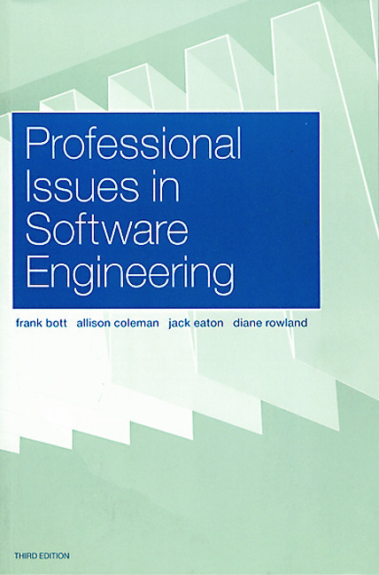
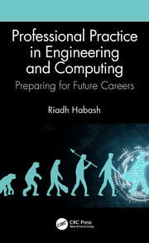
COURSE books
Professional Issues in Software Engineering by Frank Bott, Allison Coleman, Jack Eaton and Diane Rowland, CRC Press; 3rd Edition (2000)
Professional Practice in Engineering and Computing: Preparing for Future Careers, By Riadh Habash Published in 2020 by CRC press.
Notes:
Course outline

Slide 3
Course Outline
Introduction to Professionalism, Moral Principles
Ethics and codes of conduct
Structure of organization (Software House)
Financial practices
Human resource management
Intellectual property
Cyber law
Software related contracts
Social networking responsibilities and ethics
Information security and privacy
Notes:
3

Slide 4
Professional Practices and ethics INTRODUCTION

Slide 5
Professional[Meaning] | Practices[Meaning] | Ethics
A person engaged or qualified in a profession: "professionals such as lawyers and surveyors“ Synonyms: white-collar worker, professional worker, office worker Antonym: amateur A person engaged in a specified activity, especially a sport or branch of the performing arts, as a main paid occupation rather than as a part time: "his first season as a professional" | The actual application or use of an idea, belief, or method, as opposed to theories relating to it: "the principles and practice of teaching“ Synonyms application, exercise, use, operation, implementation, ... The carrying out or exercise of a profession, especially that of a doctor or lawyer: "he abandoned medical practice for the Church“ synonyms profession, career, business, work, pursuit, ... | Moral principles that govern a person's behavior or the conducting of an activity: "medical ethics also enter into the question“ The branch of knowledge that deals with moral principles. Fair/good dealing Dutiful Positive attitude
Notes:
-generate income with skill -not just ideas,practical -ethics is spirit to professionalism
-doctor/PM oath
-welfare

Slide 6
Moral Principles Encompass
Principles of Integrity[Upholding ones own principles/Making sure that they are not compromised in any way]
Principles of Double Effect[Ensuring /foreseeing/planning for long term return on actions/implementations]
Principles of Malevolence[Avoid Harmful/Hateful thoughts and actions towards a person or organization]
Principles of Benevolence[Ensuring goodwill or charitable causes]
Principles of Justice[Equality for all/Equal rights for all]
Principles of Utility[Ensuring easy implementation of tasks/jobs/activities for others]
Moral Principles are applied while ensuring Ethics
Ethics[Many Fields of Ethics]
Meta Ethics
Normative Ethics
Applied Ethics
Notes:
Meta: "What is goodness?" and "How can we tell what is good from what is bad?“, meanings of such words as 'good', 'bad', 'right' and 'wrong‘, moral judgments are absolute or relative, how we can know if something is right or wrong
Normative: "What should I do?“, how one ought to act, in a moral sense.,
applied ethics: practical questions of right behavior in given, usually contentious, situations

Slide 7
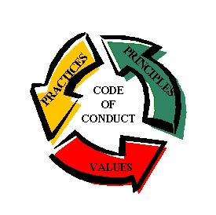
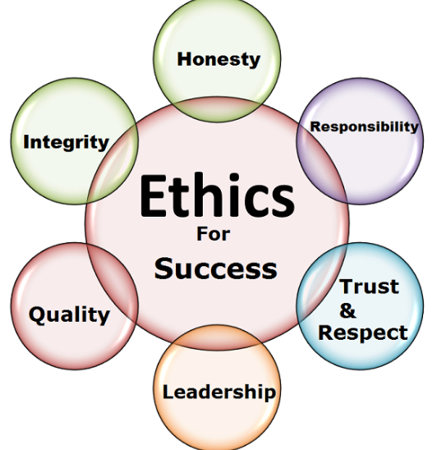
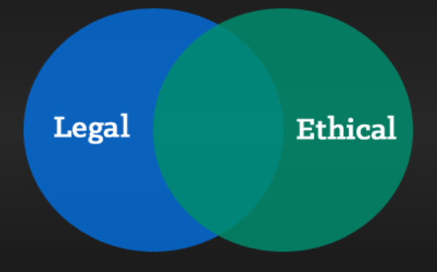
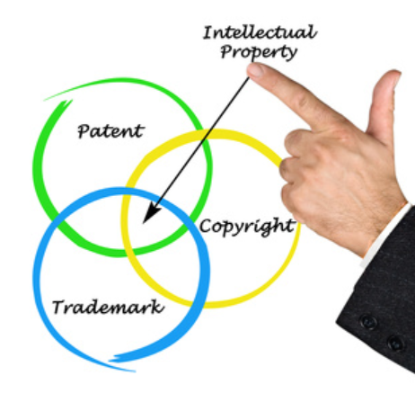
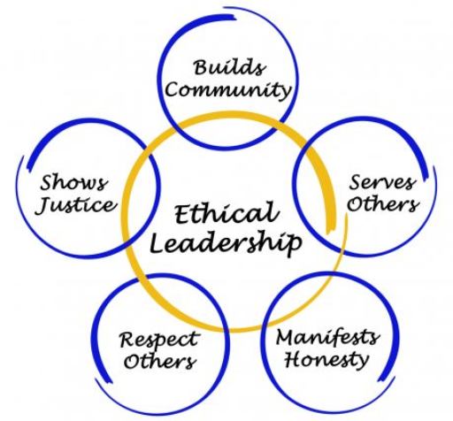

PROFESSIONAL PRACTICES
ETHICS
LEGAL ISSUES
LEGAL AND SOCIAL ISSUES
Notes:
Legal code of conduct –judge/lawyer +personal interest avoidance
Security camera surveillance legal consent
Retirement policy
Iphone sensors+drug formula

Slide 8
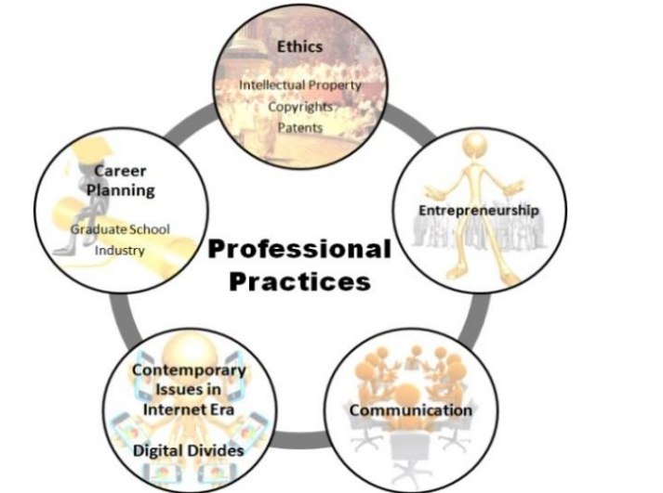

Slide 9
Why INVOLVE LEGAL SYSTEMS IN PROFESSIONAL PRACTICES
Legal system’s terms and conditions gives rights to an individual/professional with the help of contracts
Legal system ensures punishment in case of misbehavior/misdemeanor
Ensures safety of individual property
Physical Property/Asset[Personal belongings]
Virtual Property/Asset[Documents, Media files etc.]
Notes:
Undertaking at admission time-no political interference

Slide 10
Preparing students for professional practice
Student preparation for future professional practice is a major aim of the education system. Such education should integrate highly specialized knowledge with skills of contextual factors that impact the contemporary engineering and computing practice.
“I never teach my pupils, I only attempt to provide the conditions in which they can learn.”
Albert Einstein

Slide 11
Course OBJECTIVES
Study of the concept of professionalism in different domains such as Project management, Information technology, Design, Computer Science, Engineering , Artificial Intelligence etc.
Study professional practices being taken place in these domains
Applications of professional practices in industry
Understand the ethical issues in a work place/environment
Understanding the organization structure hierarchy and communication structure
Code of Ethics(IEEE and ACM) in practice
Role of character building and leadership
Understanding the impact of individuals honesty, Integrity, motivation, loyalty in company’s success
Career planning and management
Reputation /Trust building through application of professional practices

Slide 12
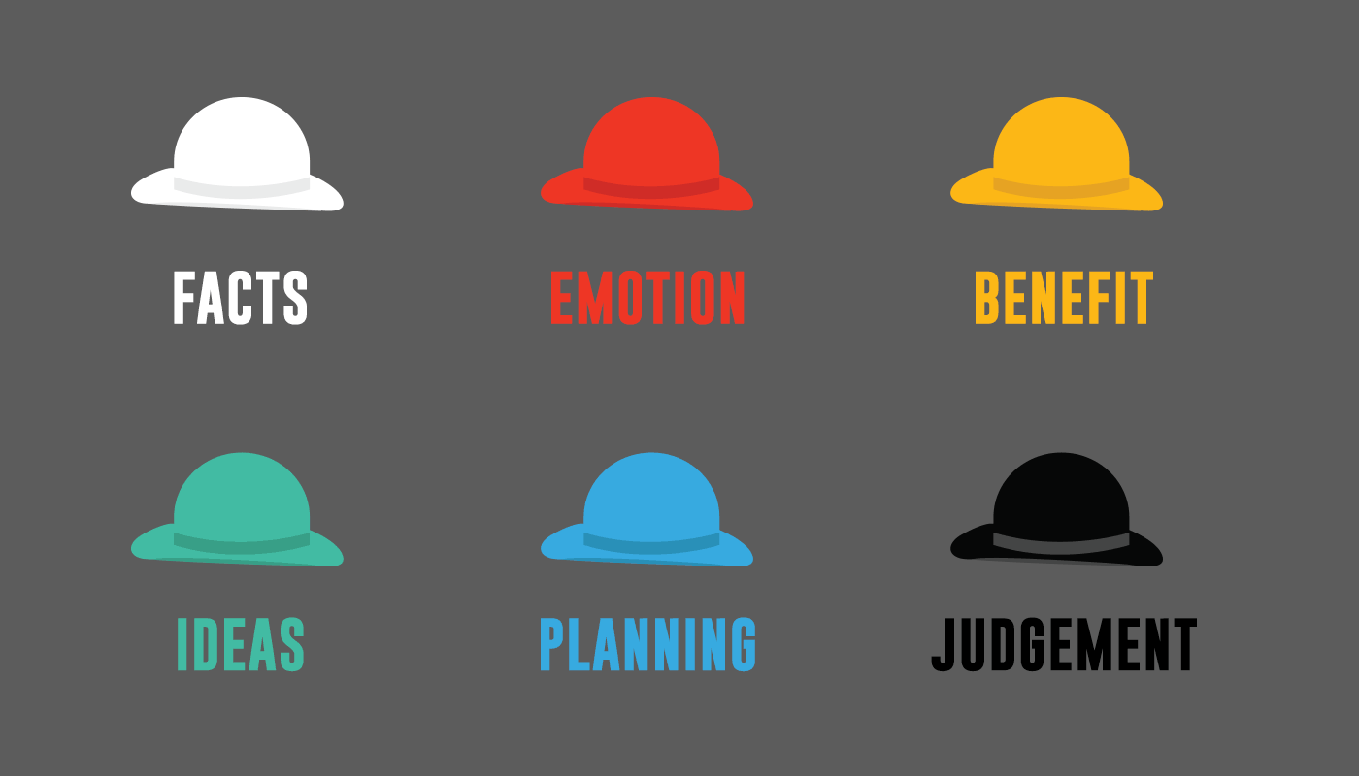
THOUGHT PROCESSES BEHIND PROBLEM SOLVING
A simple exercise to encourage diversity of thinking when problem solving.
Sometimes to generate a breakthrough you need to adopt a different mindset. The ‘Six Hats’ exercise is a useful tool to help you adopt multiple points of view on the same problem.
Each person adopts the mentality of their given hat and applies its ‘lense’ to the problem at hand. As you go around the table you will gather six very different perspectives on the same problem.

Slide 13
SCENARIO
Sarah a CS lecturer has been assigned three new courses to teach in Fall 2021.Her boss entrusts her to teach these subjects with undivided attention. She has currently started her PhD as well and seems to be having major load management issues. She is facing the dilemma that she cant refuse to teach and cant leave her doctorate.
How should she approach this scenario?
A)LEAVE JOB and continue studies
B)LEAVE DOCTERATE STUDIES and continue job
C)BARE THE PRESSURE /ENDURE THE PRESSURE

Slide 14
FACTS:ENDURE THE PRESSURE AND NEXT TIME INFORM BOSS TO REDUCE HER WORK LOAD
EMOTIONS:SHE WOULD OPT TO RESIGN OR LEAVE EITHER ONE OF THESE RESPONSIBILITIES
BENEFITS:ENDURING THE PRESSURE AND KEEPING UP WITH BOTH RESPONSIBILITIES
SHE MIGHT OPT TO INVEST HER TIME IN PhD Because she thinks that her future career is dependent on it.

Slide 15
IDEAS:[HOW WILL SHE DELEGATE RESPONSIBITY]
IDEA 1:TO ASK ONE OF HER COLLEAGUES TO CO-SUPERVISE HER COURSES TO DIVIDE THE WORK LOAD.
IDEA 2:SHE COULD REDUCE THE NUMBER OF COURSES SHE CHOOSES TO STUDY IN PhD programs.
PLANNING:INCORPORATING IDEAS TO DELEGATE RESPONSIBILITY
REORGANIZING OR MANAGING HER DAY TO DAY TASKS
JUDGEMENT:[THINKING HOW OTHERS WOULD PERCEIVE HER CHOICES]
THE JUDGEMENTS OF HER BOSS IF SHE LEAVES HER JOB/REDUCES WORK LOAD etc.
THE JUDGEMENT OF PEERS IN HER PhD Program if she decides to reduce course work or freeze her semester.

Slide 16
Lateral THINKING VS VERTICAL THINKING
Vertical Thinking | Lateral thinking
Rigid way of thinking Conventional way of thinking Moving forward through selection of steps , where each step must be validated to move forward | Flexible way of thinking Generating new ideas Creative thinking process Thinking about the problem from different view points / angles and generating new approaches
Question : Solve the following problem 5x5=……. | Solution one :Answer through Multiplication table 5x5=25 Solution two: Answer through Addition 5+5+5+5+5=25
Notes:
Horse example

Slide 17
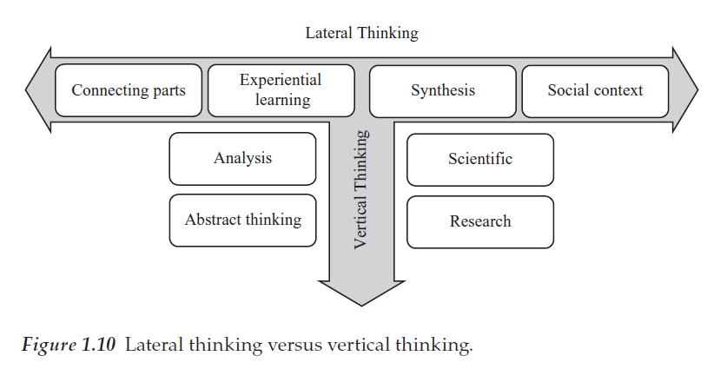
Lateral THINKING VS VERTICAL THINKING

Slide 18
Professionalism
It is a key cluster of social and ethical responsibility, commitment, knowledge and skills, and judgment in the sociologies of work , occupations, professions, and organizations Hurd (1967)
Professionalism Quote:
It’s not the job you do; it’s how you do the job. Anonymous

Slide 19
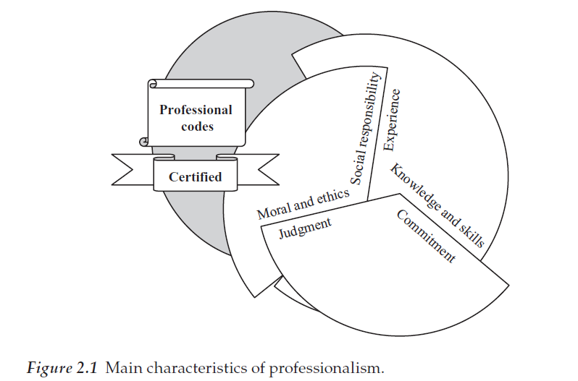
CHARACTERISTICS OF PROFESSIONALISM

Slide 20
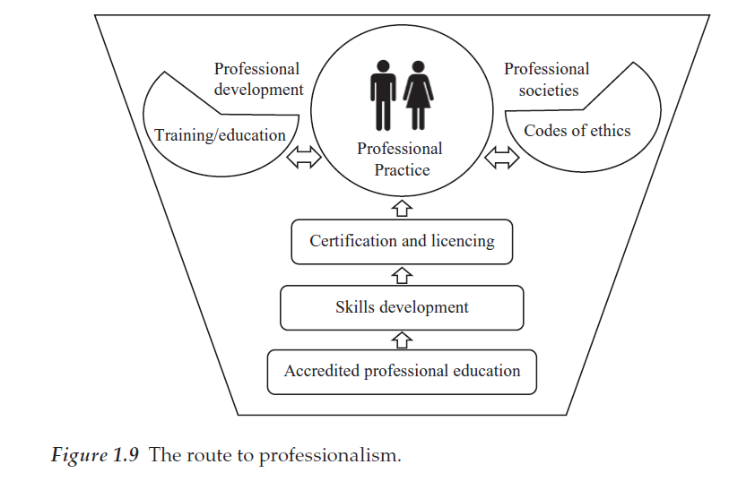
ROUTE TO PROFESSIONALISM

Slide 21
Task Assignment 01
Present 05 min session on great moral Philosophers either from historical and modern age. Discuss their philosophical theories and contribution in applied ethics.
Historical Division of moral Philosophers | Timeline
GREEK | 400-500 BC
CHINESE | 500 BC
ARAB | 800 AC
EUROPEAN | 1300 AC
AMERICAN | 1800
GLOBAL | 1950 –Applied Ethics
Notes:
Confucius Archimedes plato Aristotle

